Slide 1
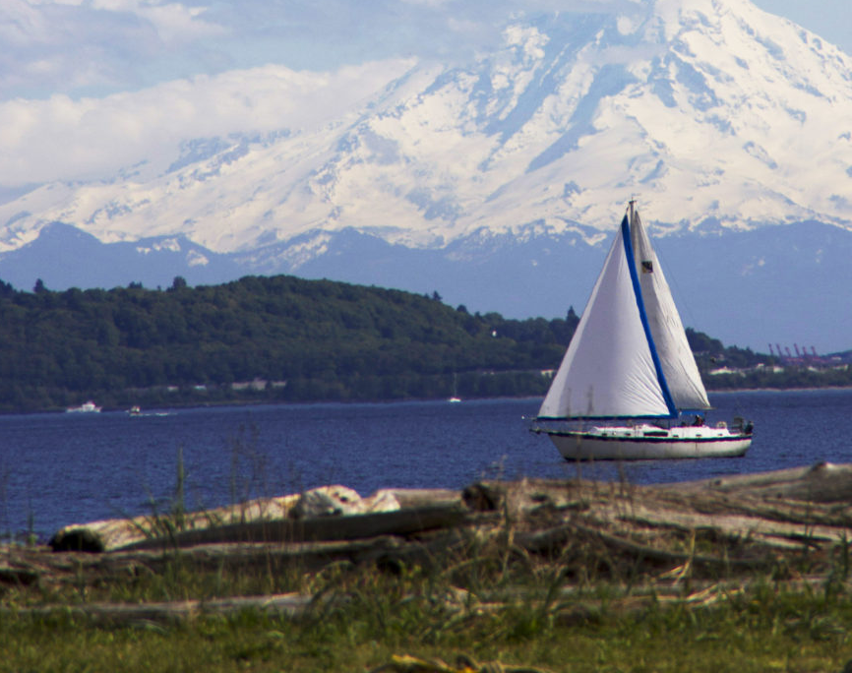
MOFFAT BAY PROJECT BELLEVUE UNIVERSITY CSD 460 CAPSTONE
Joel Avery
Andrew Danielson
Tabark Kambal
Gabriel Pedraza Torres
10 DECEMBER 2023

Slide 2
Team Introduction
Joel Avery
Married for three years
Have two kids and a husky
Work for a company that uses automation to slice meat. (checkout Weber Inc on youtube)
Won Three state championships in football
Made the Missouri sports hall of fame
Played in 4 NFL stadiums.

Slide 3
Team Introduction
Andrew Danielson
Married 17 years
Five Children – Four boys and one girl; ages from 15 to 3(girl)
Active Duty USAF (17.5 years of service)
Currently stationed in Germany at Spangdahlem Air Base
Has had the same job the entire time Munitions Systems
I ensure that USAF aircraft can do their specific missions and do it safely
I build bombs 💣
Earned two Associate of Applied Science degrees
Munitions Systems Technology – Community College of the Air Force
Electronics Technology – College of Western Idaho

Slide 4
Team Introduction
Tabark Kambal
Married for 3 years
Two Children – two boys and one one the way; ages 2.5-1 years old.
Going for first degree with Bellevue University
AGR National Guard Supply NCO
Currently working at Camp Ashland Regional Training Site(RTI)
Providing logistic support for the RTI

Slide 5
Team Introduction
Gabriel Pedraza Torres

Slide 6
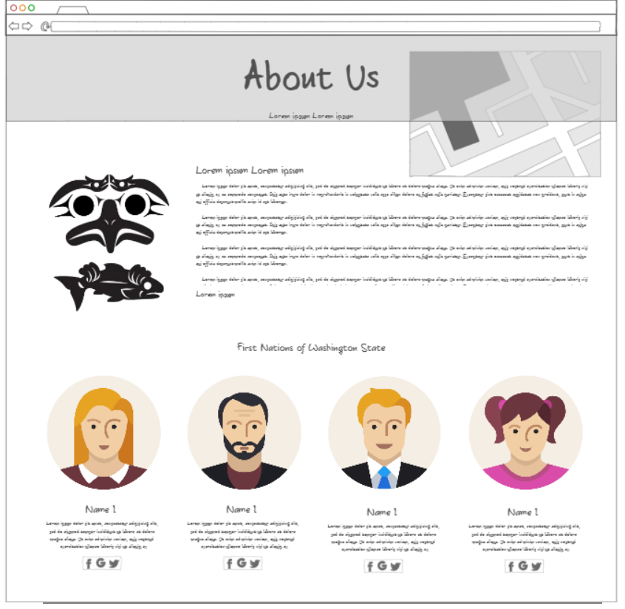
Prototypes and Mock-ups
About Us page
Similar layout, but still is different.
Added link to First Nations website.

Slide 7
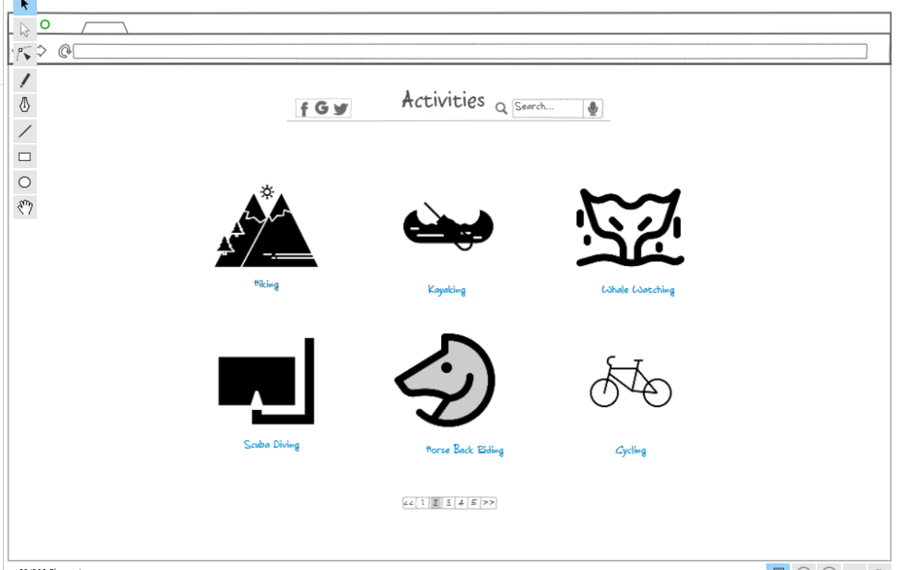
Prototypes and Mock-ups
Mock-up for the Moffat Bay Lodge Activities Page.
Initial had one container with multiple images
Live page, did not end up looking like this.

Slide 8
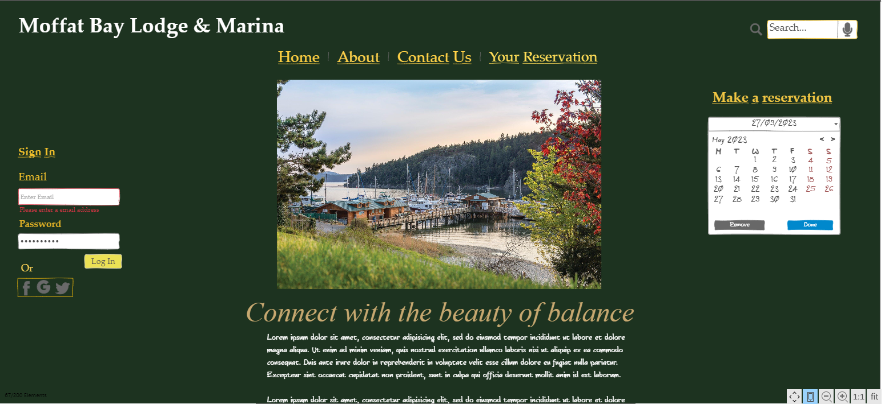
Prototypes and Mock-ups
This was the prototype for the landing page.
We maintained a similar layout, but with cleaner lines.

Slide 9
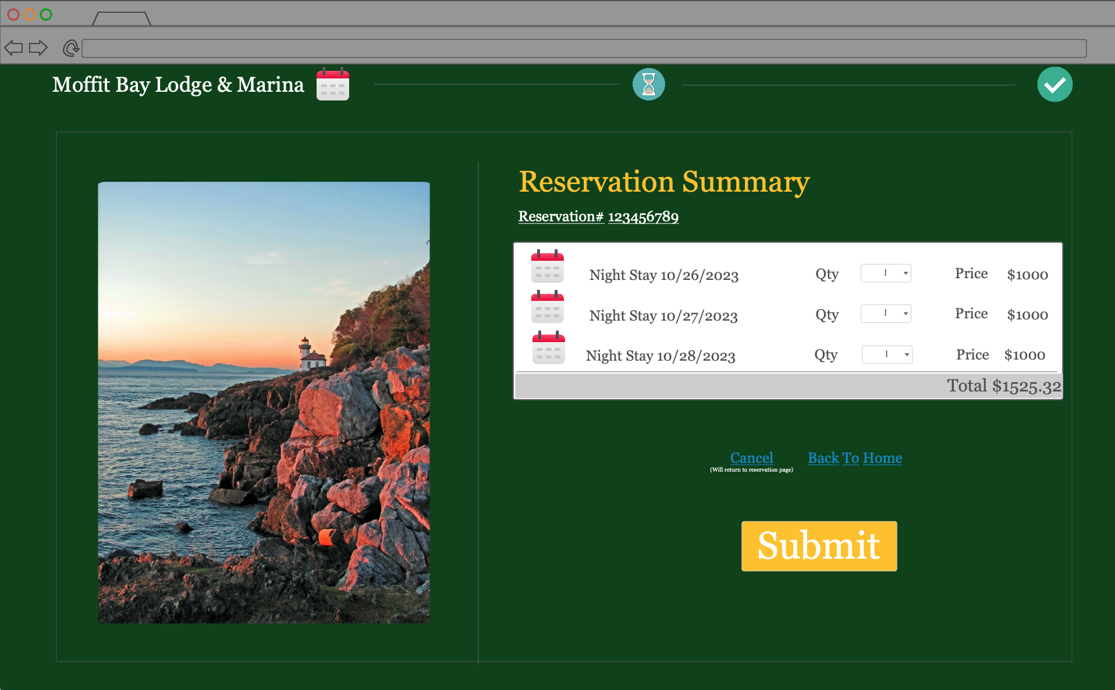
Prototypes and Mock-ups
Reservation Summary Page
Similar to the production
Simplified with Dropdowns to allow for a single room type.

Slide 10
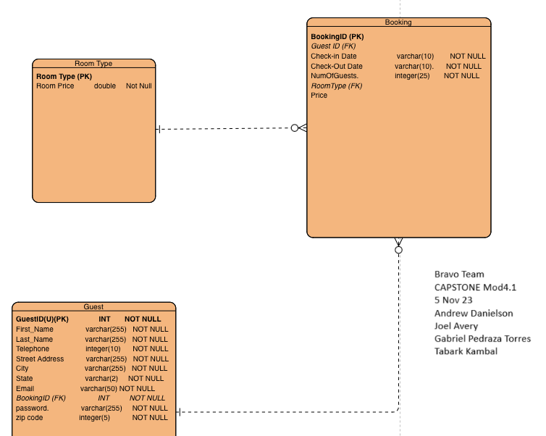
Entity Relationship Diagram

Slide 11
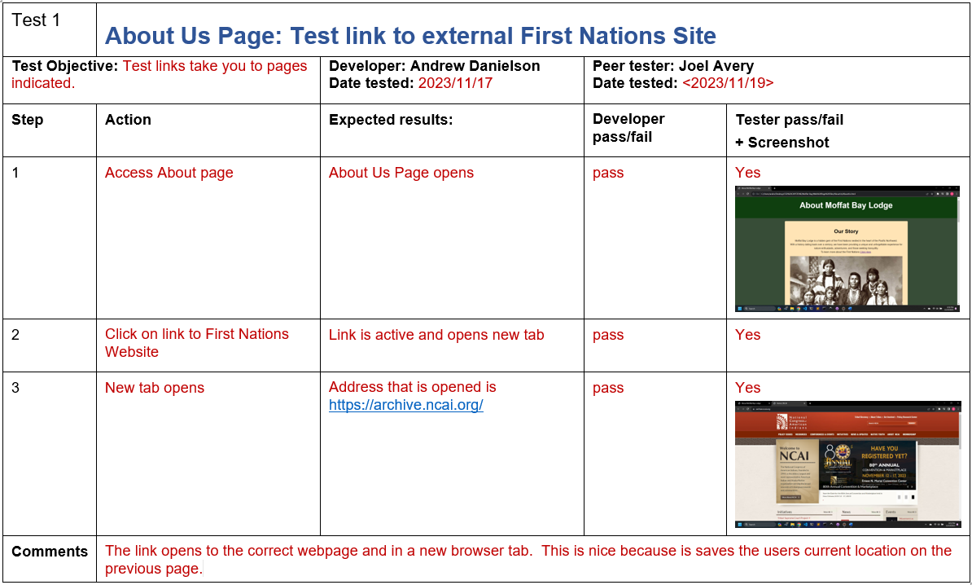
Test
This test was to see if the link to an external site was able to open a new tab and direct that tab to the site.
Result Pass

Slide 12
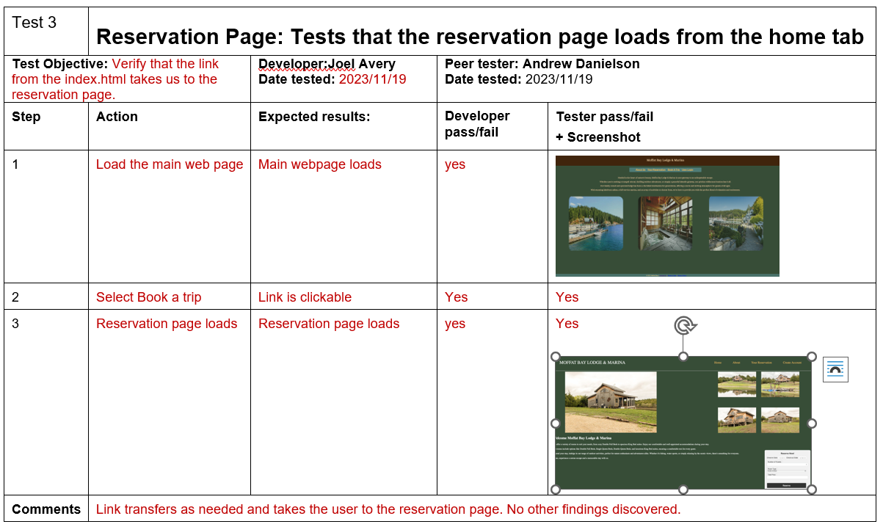
Test
Simple test to validate if the links would take the user from the home page to the reservations page using the link below the header.
Result: Pass

Slide 13
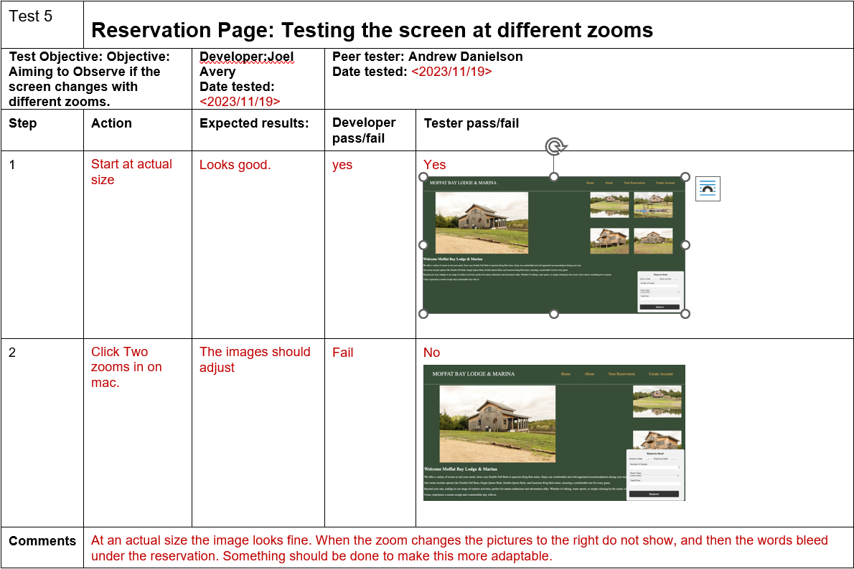
Test
Check to see how responsive the page was to zoom.
Responsive zoom did not function as intended.
Result: Fail

Slide 14
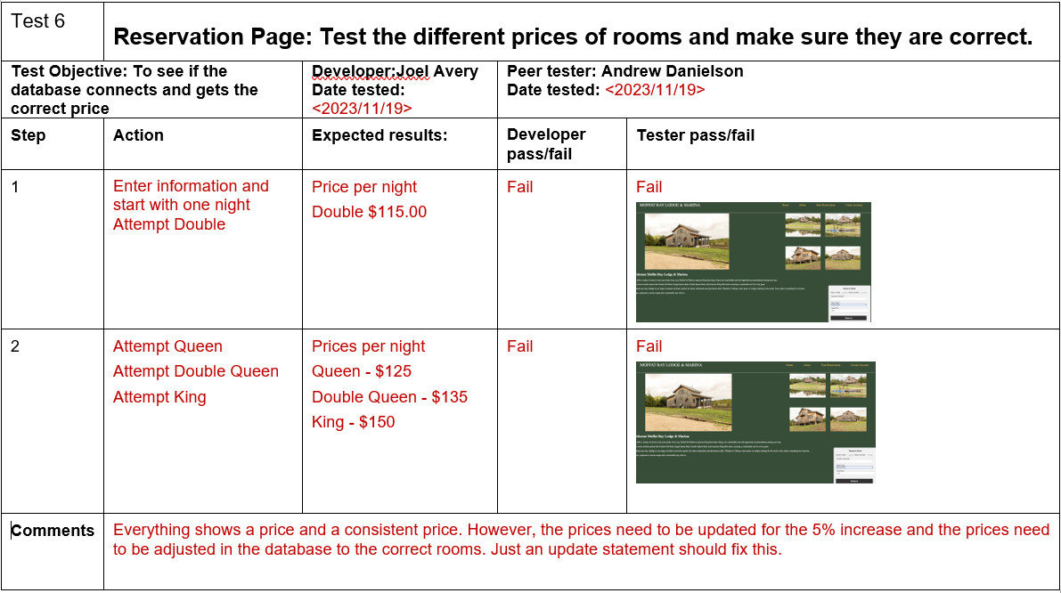
Test
Validate the price of rooms on the reservation page using dropdowns.
Prices did change as intended but were incorrect in the database.
Result: Fail – Due to incorrect prices being displayed

Slide 15
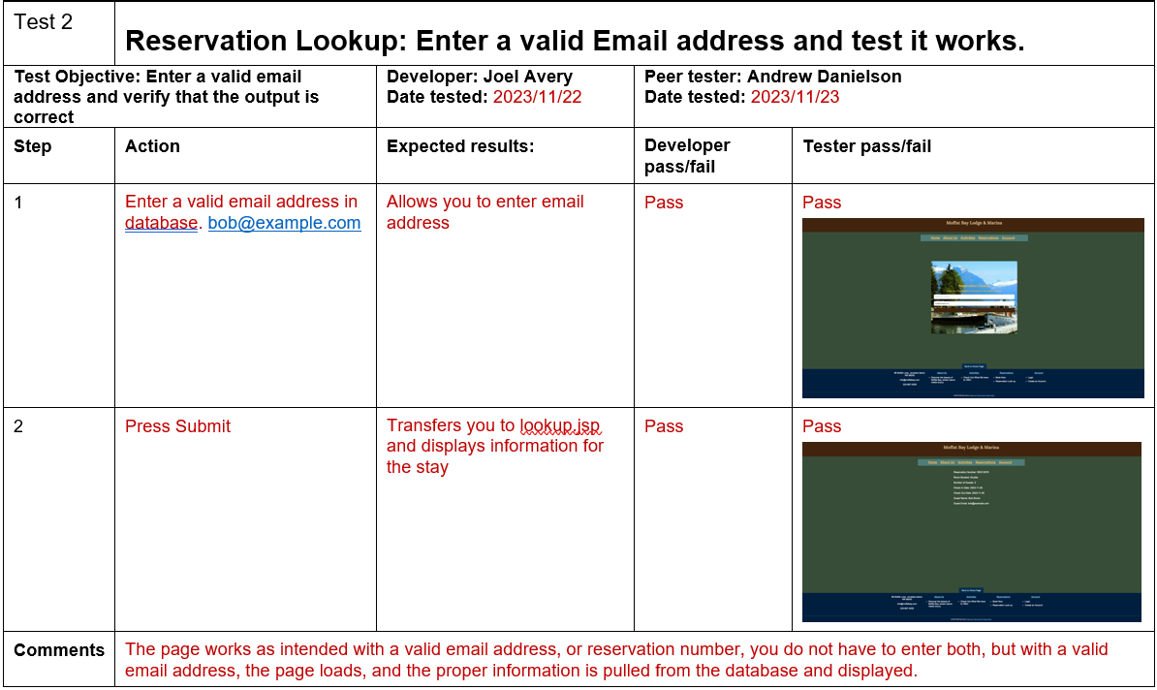
Test
Look up reservation using email address
Displays results from the database indicating the customers reservation
Result: Pass

Slide 16

Lessons Learned
Meet early; do not just use a message board.
Consistent code formatting
Repository set up and formatting
File location
Use of same software
Consistently push changes to repository
Create a branch if unsure of the changes

